Slide 1


Project 4 – Predicting Employee Attrition
Ayesha Maryam, Athul Madhusudhanan, Mujahid Iqbal, Edward Vaughan, Daniel Daniel

Slide 2
Background
Employee attrition – the departure of an employee(s) from employment, for whatever reason, be it voluntary or involuntary.
Attrition in the UK is around 16.8%.
20% is the accepted maximum threshold.
Logistic Regression model to predict attrition.

Slide 3
Data Source
IBM HR Analytics Employee Attrition & Performance
From IBM
Sourced from Kaggle: https://www.kaggle.com/datasets/pavansubhasht/ibm-hr-analytics-attrition-dataset/discussion/233758
Wide variety of metrics to analyse
1470 records

Slide 4
Data Importing

Slide 5
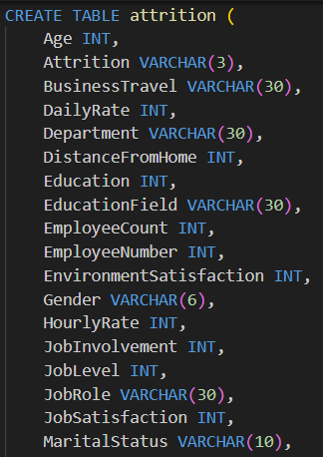
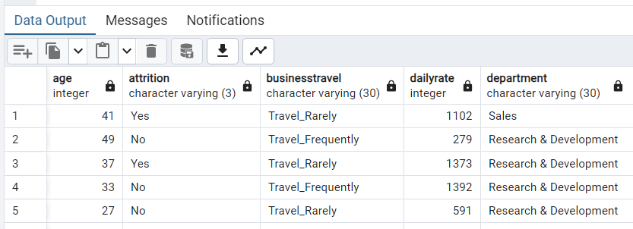
PostgreSQL
CSV imported into SQL with this schema.
SQL Table import verified.

Slide 6
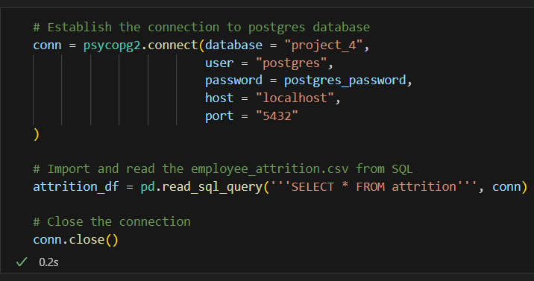
Psycopg2
Database connection established.
SQL query executed, and DataFrame created.
Connection closed at the end.

Slide 7
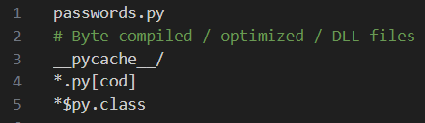
gitignore
File containing postgres password (passwords.py) added to gitignore.

Slide 8
Data Preprocessing

Slide 9
Input Data
Column | Description
Age, Gender, Marital Status, Over 18, Work Life Balance, | Personal Details | Features
Daily Rate, Hourly Rate, Monthly Income, Monthly Rate | Salary
Business Travel, Distance from Home | Commute
Education, Education Field | Education
Department, Job Level, Job Role | Job Details
Environment Satisfaction, Job Satisfaction, Relationship Satisfaction | Job Satisfaction
Num Companies Worked, Total Working Years, Years At Company, Years In Current Role, Years With Curr Manager | Work History
Job Involvement, Percent Salary Hike, Performance Rating, Years Since Last Promotion | Job Performance
Employee Number, Employee Count | Identification Details
Overtime, Standard Hours | Hours
Training Times Last Year | Other
Stock Option Level | Perks
Attrition | Attrition | Target

Slide 10
Dropping columns
EmployeeCount
“1” for all employees.
EmployeeNumber
Identification Number
Over18
All participants were over 18
Standard hours
All staff worked the same standard hours of 80.

Slide 11
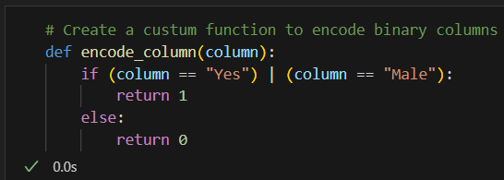
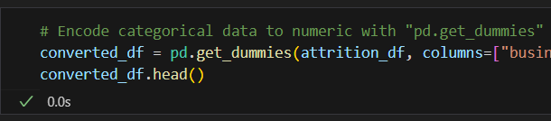
Encoding
Attrition
Yes or No
Gender
Male or Female
OverTime
Yes or No
BusinessTravel
Department
EducationField
JobRole
MaritalStatus

Slide 12
Logistic regression model

Slide 13
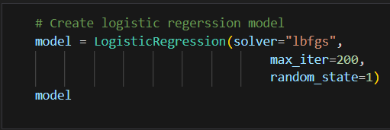

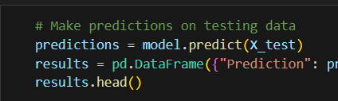
LR MODEL
Random state of “1”, used across the whole project, (for further reproducibility)

Slide 14
Evaluation

Slide 15
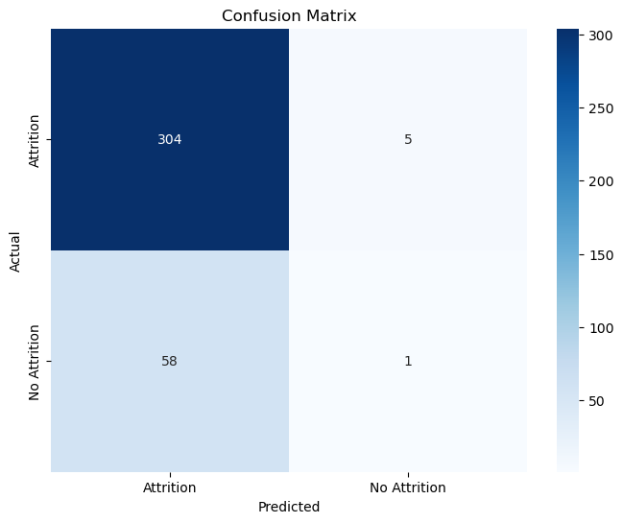
Evaluating the lr model
accuracy | 0.83
 | precision | recall | f1-score
Attrition | 0.84 | 0.98 | 0.91
No Attrition | 0.17 | 0.02 | 0.03

Slide 16
Optimisation

Slide 17
Optimisation methods
Further pre-processing
Dropping more columns
Only using the most important features:
Comparing model coefficients
Permutation analyis
Correlation analysis
RFE (Recursive Feature Elimination)

Slide 18
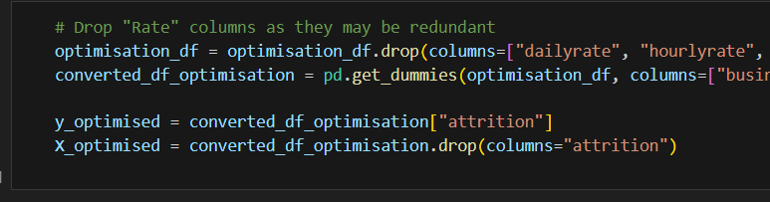
Further pre-processing
“rate” columns dropped

Slide 19
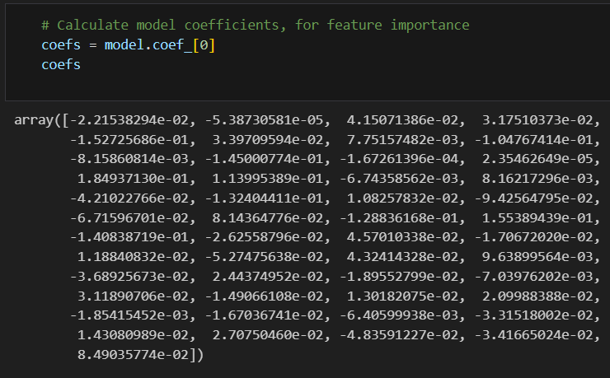
Model coefficients
Model coefficient array converted to DataFrame, and then bar plot.
Absolute values were used, so only the magnitude of importance was considered.
Bar plot was created.

Slide 20

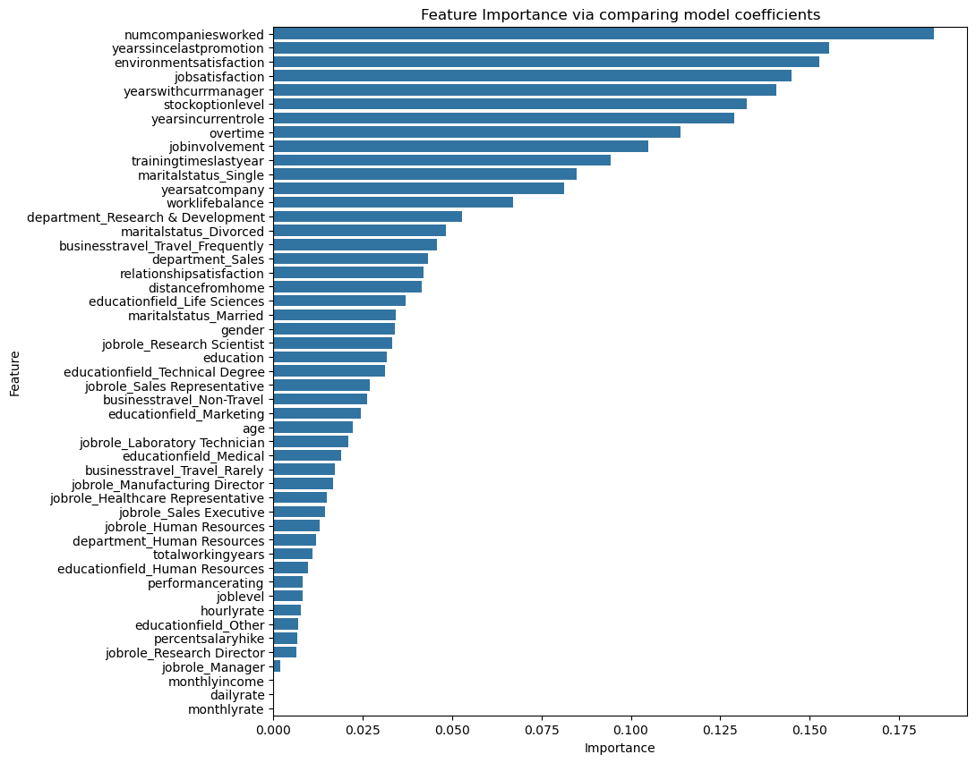

Slide 21
permutations

Slide 22
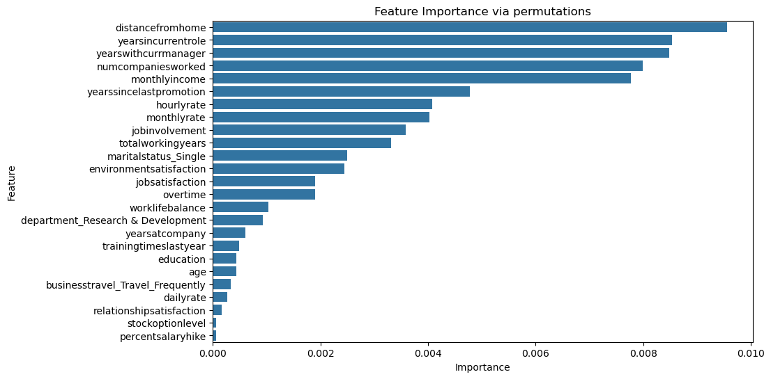

Slide 23
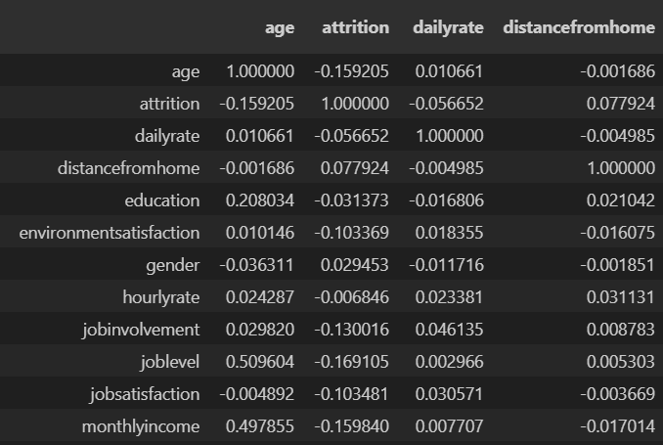

Correlation analysis

Slide 24
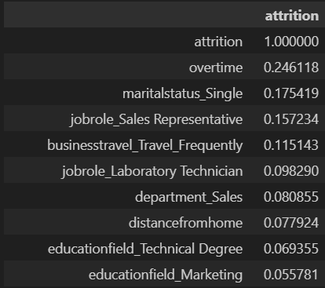
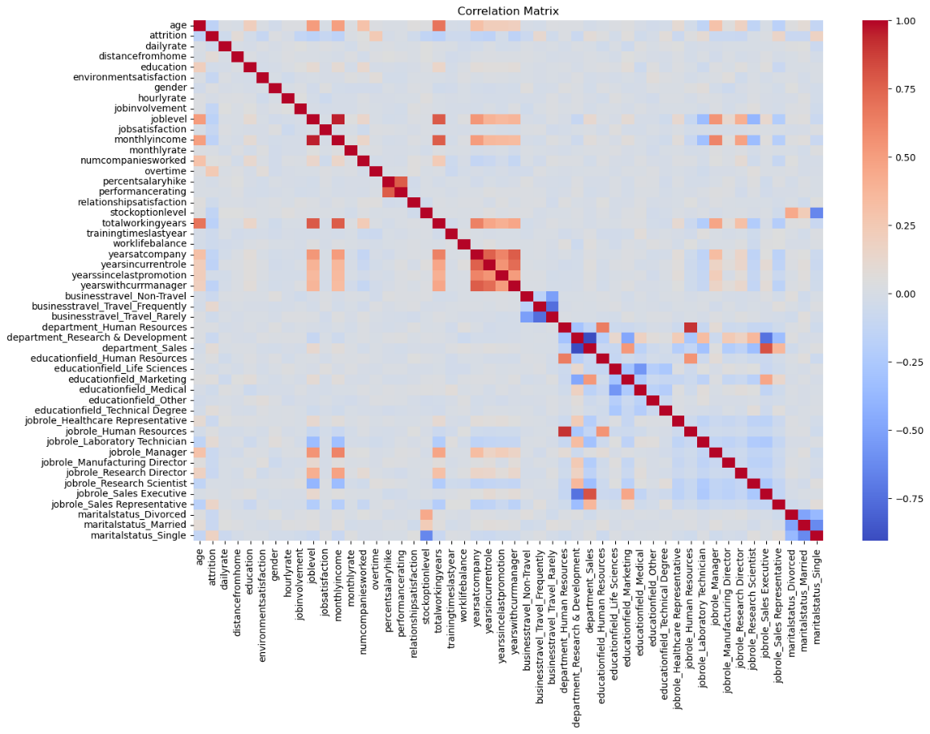

Slide 25
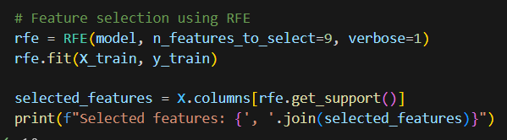
RFE (Recursive Feature Elimination)

Slide 26
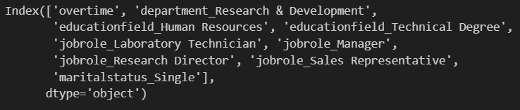

Slide 27
Optimisation Evaluation
Method | Accuracy (%)
Base model | 83
Optimisation with further pre-processing | 83
Optimisation with RFE | 85
Optimisation with Permutation analysis | 83
Optimisation with Correlation analysis | 84
Optimisation with Coefficient analysis | 84

Slide 28
Summary
85% accuracy was achieved after optimising with RFE.
Feature importance selection was fairly balanced throughout.
Further analysis ideas:
“Binning” data
Selecting more features.
Closer look at pre-processing?
Combining methods

Slide 29
Thanks for Watching!

